Slide 1

Introduction To Databases
M2-D1
Participate! The more engagement the better! You are NEVER interrupting me!

Slide 2
Module 2 Overview
Week 1: SQL / Database Design
Week 2: Calling databases from JAVA using SQL / Integration Testing (Spring Boot / Spring DAO)
Week 3: Web Services (Client / Server, REST, APIs, HTTP - Spring Boot, Spring Security)
Week 4: M2 Capstone / holiday week

Slide 3
Week 5 at a glance
Monday: Intro to Databases and SELECT statements
Tuesday: SELECT (ORDER BY / Aggregate functions / GROUP BY)
Wednesday: SELECT (SQL Joins)
Thursday: INSERT, UPDATE, DELETE
Friday: Database Design (Pair and individual)

Slide 4
Objectives
Introduction to Databases
Tables, Rows, and Columns
ANSI-SQL Data Types
SQL Queries: Selecting data using SELECT

Slide 5
Intro to Databases
A database is an organized collection of data that can be accessed, managed, and updated.
A relational database is a particular type of database built upon the relational model of data
Data in a relational database can be accessed and reassembled in many different ways without having to reorganize the data.
Each entity is stored in a table.
Columns are called attributes
Rows represent individual records.
Rows represent individual records and consist of many attributes organized using columns.

Slide 6
City Table
Column
Tables have a set number.
Define the data the table will hold
id | name | countrycode | district | population
1 | Kabul | AFG | Kabol | 1780000
2 | Qandahar | AFG | Qandahar | 237500
3 | Herat | AFG | Herat | 186800
4 | Mazar-e-Sharif | AFG | Balkh | 127800
5 | Amsterdam | NLD | Noord-Holland | 731200
6 | Rotterdam | NLD | Zuid-Holland | 593321
7 | Haag | NLD | Zuid-Holland | 440900
8 | Utrecht | NLD | Utrecht | 234323
9 | Eindhoven | NLD | Noord-Brabant | 201843
10 | Tilburg | NLD | Noord-Brabant | 193238
Row
Tables have a unlimited number (0...n)
Contain the data
Cell
The intersection of a column and row
Used to identify a specific value or row

Slide 7
(R)DBMS
A Relational Database Management System ( (R)DBMS) is a software application designed to manage a database. It has four basic functions
Data Definition
Data Storage
Data Retrieval
Administration
RDBMSs include databases like Oracle, Microsoft Sql Server, PostgreSQL, MySql, are relational, and are commonly called SQL Databases.
NoSQL Databases are those that do not use a relational structure, instead they structure data specific to the problem they are designed to solve. NoSQL databases include MongoDB, Cassandra, Google BigTable, HBase, DynamoDB, and Firebase

Slide 8
ANSI SQL
SQL - Structured Query Language : a language that lets you access and manipulate databases
ANSI-SQL - A standard that databases must follow to be considered a SQL Database.
All SQL databases support the ANSI-SQL language, however, most databases extend it with their own proprietary additions.

Slide 9
Structured Query Language (SQL)
A declarative programming language used to manage a database and its data.
Consists of 3 sub-languages
DDL - Data Definition Language - defines the structure of the data
DML - Data Manipulation Language - query and modify the data
DCL - Data Control Language - used to administer the database
A declarative programming language specifics what actions should be performed rather than how to perform those actions.

Slide 10
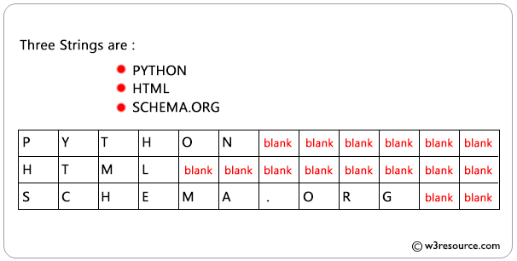
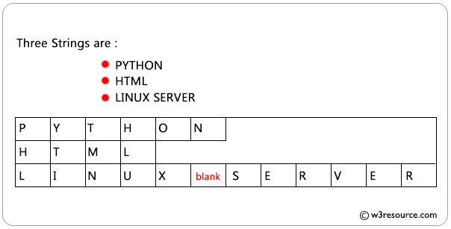
Character Data Types
char(#) - character. # defined the length of the data.
varchar(#) - varying character. # defined the length of the data.
text - text based data that is not limited by a predefined size
char(12)
varchar(12)

Slide 11
Numeric Data Types
int or integer - similar to Java’s int
bigint - Big Integer, similar to Java’s long
decimal(p, s) - floating point numbers, similar to Java’s double or BigDecimal
p - precision - the total number of digits being stored
s - scale - number of digits to the right of the decimal point
1234.567 has a precision of 7 1234.567 has a scale of 3

Slide 12
Other Data Types
boolean - true/false
Not the same in all SQL databases
Mysql - tinyint(1)
PostgreSQL / Oracle - boolean
MS Sql - bit
DATE
yyyy-mm-dd
TIME
hh:mm:ss
TIMESTAMP / DATETIME
yyyy-mm-dd hh:mm:ss
Date and Time datatypes also support the usage of 24-hour vs 12-hour clocks and Time Zones.

Slide 13
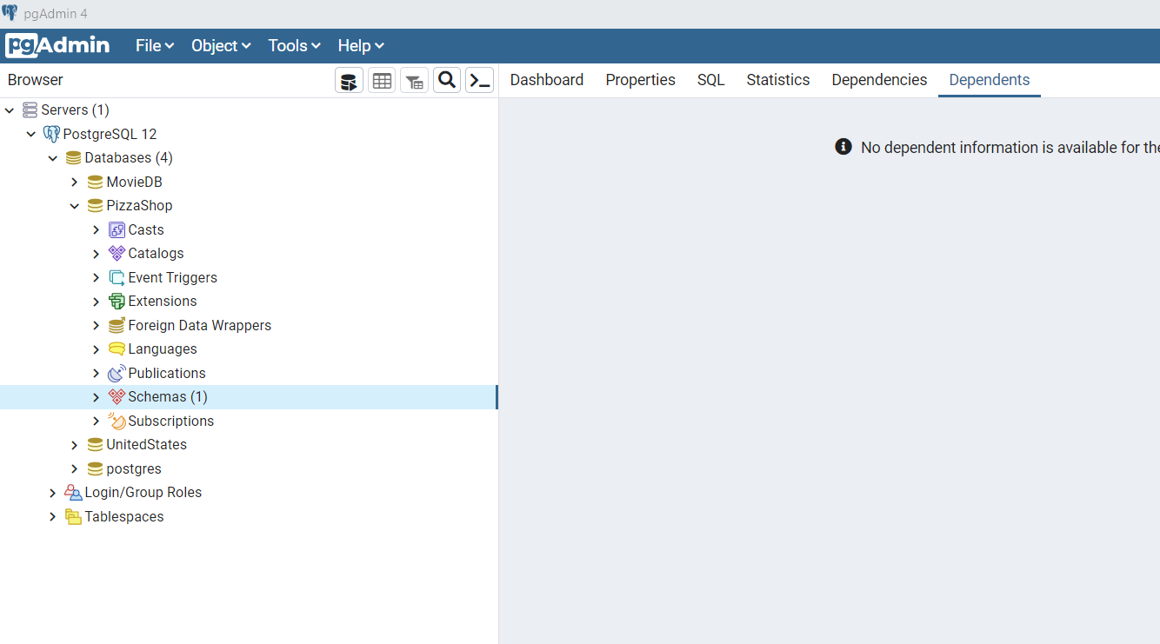
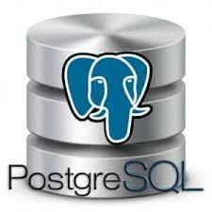
Tools
PGAdmin - This is not Postgress or the database, this is a UI tool to help developers write and run SQL
connects to
Postgres - Postgres is a relational database management tool. It can manage many databases

Slide 14
PgAdmin Tour - Create databases
Run scripts
Execute Queries

Slide 15
Structured Query Language (SQL)

Slide 16
SELECT
The SELECT clause indicates what columns that you want to get from a database table.
The FROM clauses indicates which table(s) to retrieve the data from.
SELECT name, population FROM country;
DISTINCT can be used with a column name to return only unique values.
SELECT DISTINCT city_name FROM city;
AS can be used with a column name to give it an Alias (new name)
SELECT city_name AS CITY FROM city
Or to give a name to a combines result:
SELECT ( col1 + col2 ) AS ‘Sum’
* can be used to select all columns from a table.
SELECT * FROM city;

Slide 17
WHERE
The WHERE clause is used to filter the rows returned in the results using conditional clauses.
SELECT * FROM city WHERE city_name = 'Akron';

Slide 18
WHERE Clause Conditionals
Conditionals can be chained together using AND and OR.
Precedent can be set using ()
Example:
WHERE num > 5 AND (name LIKE ‘A%’
OR name LIKE ‘B%’)
= | equal to
!=, <> | Not equal to
>, <, >=, <= | Greater/Less Than
IS NULL | value is null
IS NOT NULL | value is not null
IN (val1, val2, …) | Value is IN the list
NOT IN (val1, val2, …) | Value is NOT IN the list
BETWEEN val1 AND val2 | The value is between the 2 values Example: number BETWEEN 2 AND 10;
LIKE (%) | The value matches a pattern created with % Example: a% - the value starts with a %a - the value ends with a %a% - the value contains an a
Strings in SQL use single quotes.
name = ‘John’

